Slide 1
IEEE RAS PCB DESIGNING INTERNSHIP
Akshay K B :PES1UG20EC802
Kanusha R K :PES1UG19EE046
Manasa K :PES1UG19EE057

Slide 2
PROBLEM STATEMENT
This project intends to minimize the time spent on wiring and checking circuits by designing PCBs.
Two PCBs with the given specifications were to be designed.

Slide 3
SPECIFICATIONS OF PCB-1
Slots to insert arduino Uno.
Slots to insert motor driver.
Slots to insert sensors & (5 slots for - 5V pins and 3.3V, 5 slots for -GND pins).
Slots for digital and analog pins,Spi,I2C.
Slots for inserting two motor wires.
Slots for stepper motor driver a4988.
Slot to connect any battery of more than 12 volt rating via XT60 connector.

Slide 4
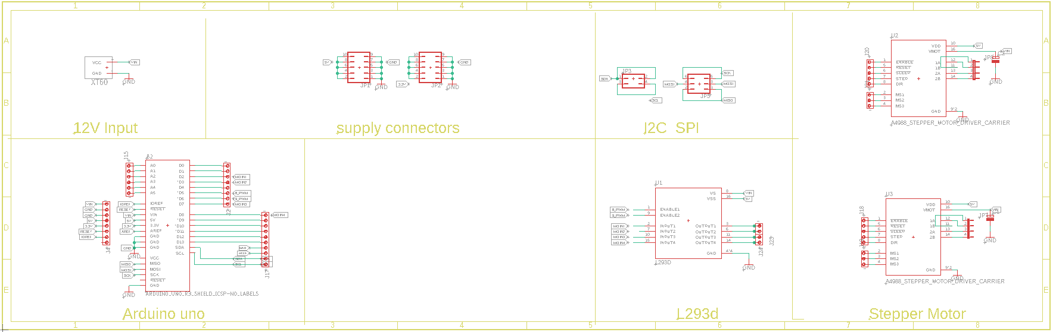
APPROACH
The software tool used for creating PCB-1 is EAGLE.
CIRCUIT DIAGRAM

Slide 5
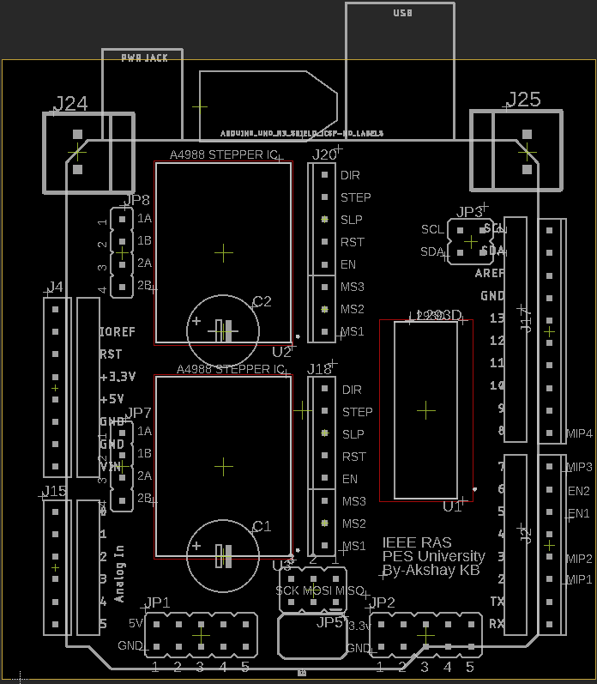
PCB LAYOUT

Slide 6
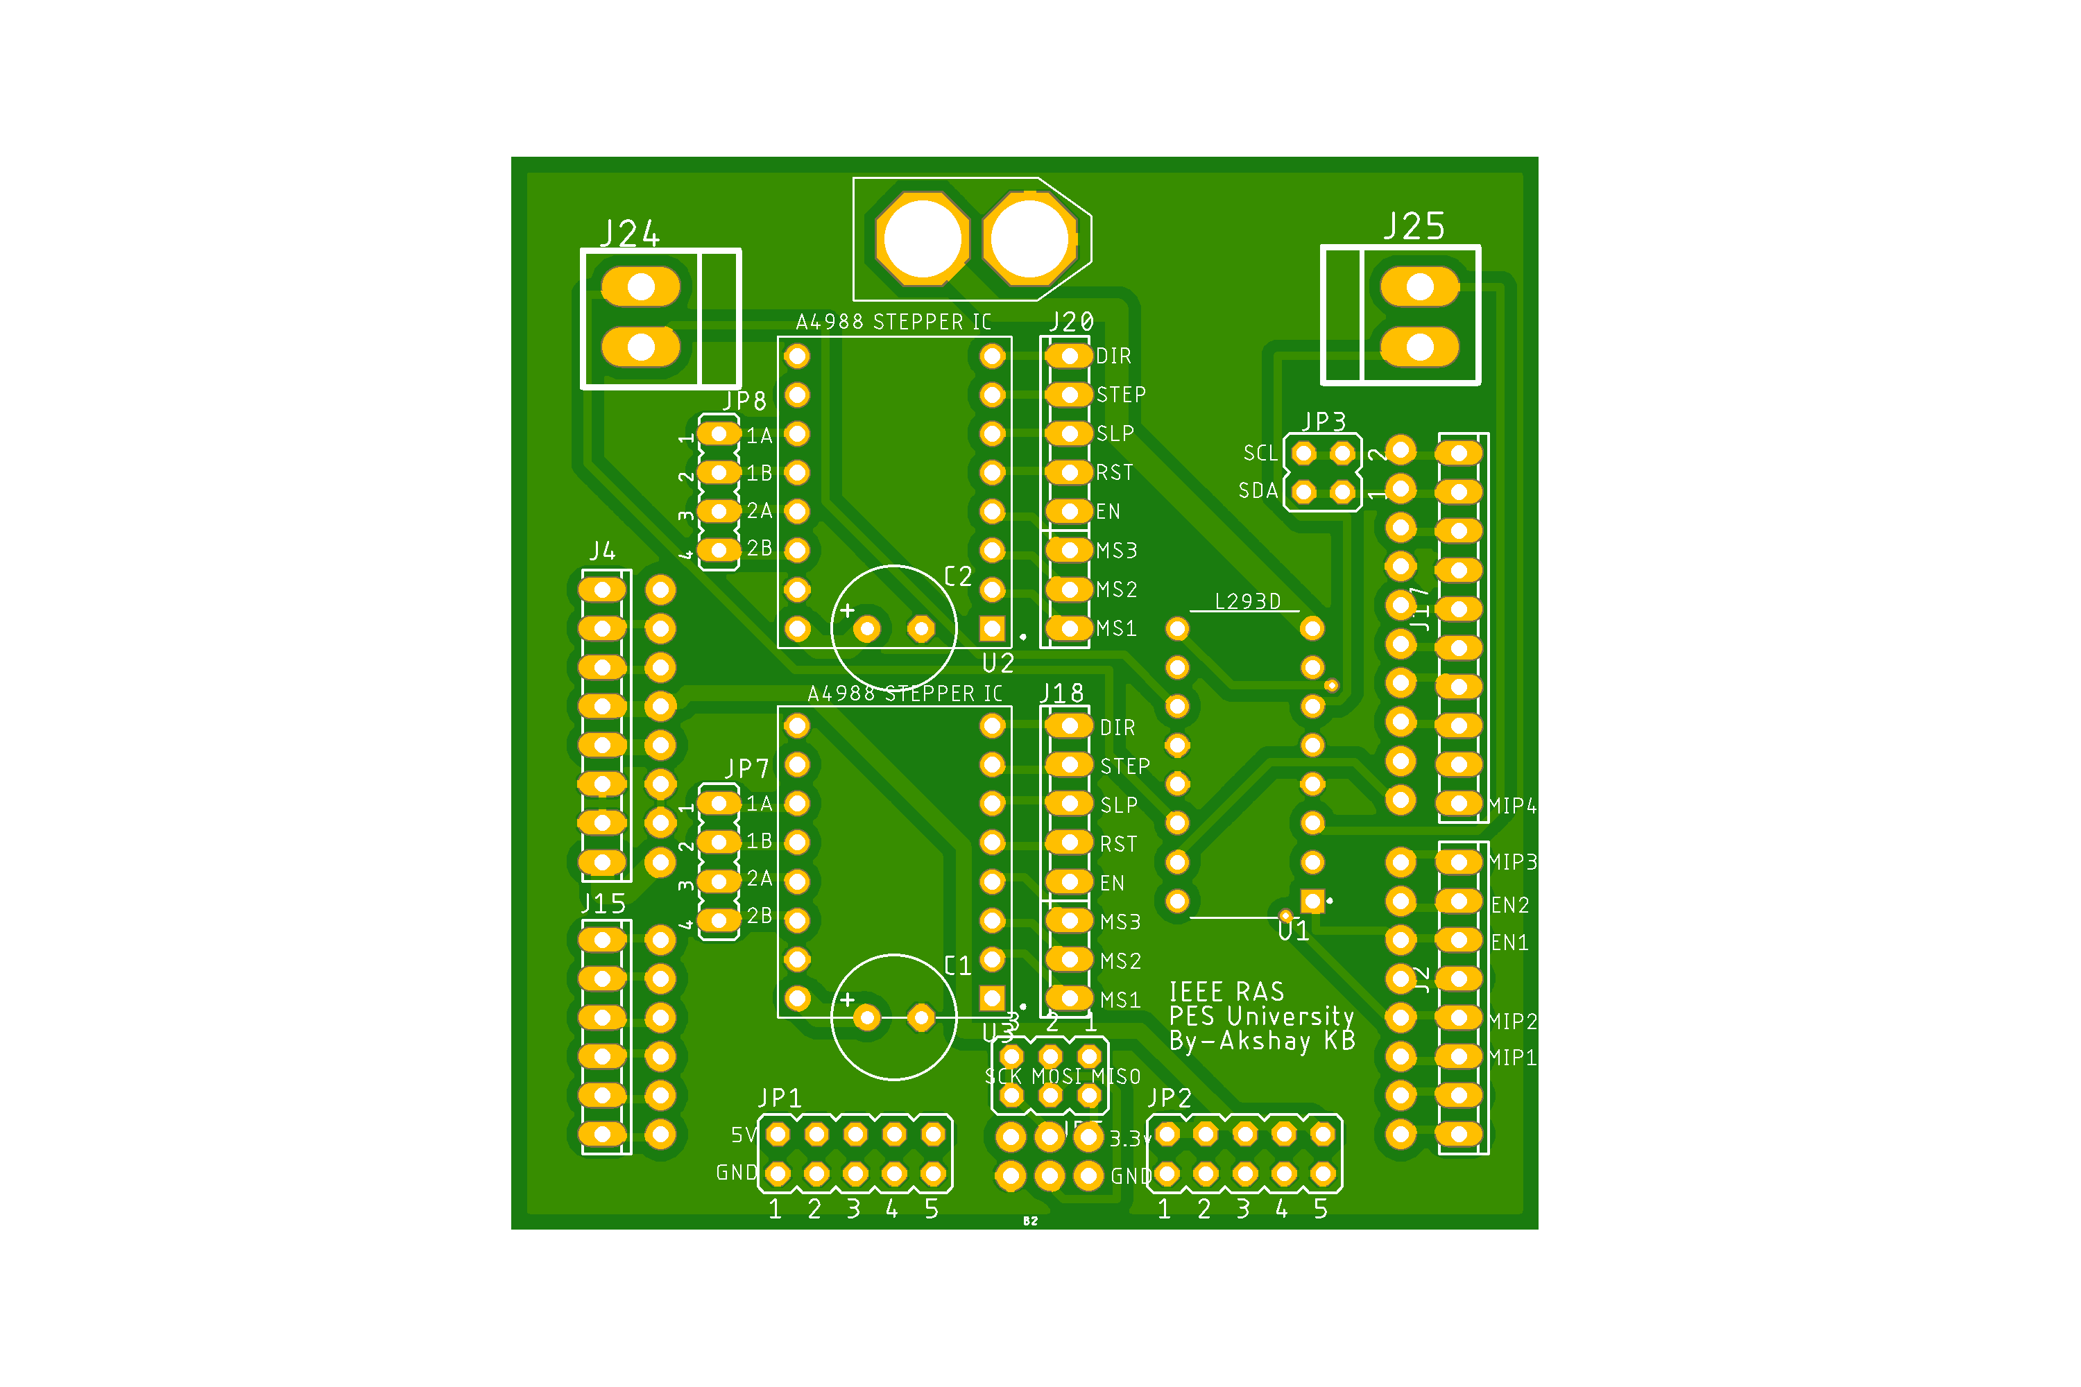
PCB AFTER PRODUCTION
Sl.no | component | Qty | Referance
1 | Screw Terminal | 2Pcs | J24,J25
2 | A4988 Stepper driver | 2pcs | U2,U3
3 | XT60 connector | 1pc | Lipo battery
4 | L293D IC | 1pc | U1
5 | Arduino Uno | 1pc | To the male Berge connector
6 | Berge connector male | 3-4strips | Arduino slot,JP7,JP8,JP20,JP18,JP3,
7 | Capacitor 100uf | 2pcs | C1,C2 after solder bend it
BILL OF MATERIAL(BOM) COMPONENTS REQUIRED

Slide 7
SPECIFICATIONS OF PCB-2
slots to insert Arduino NANO
slots to insert motor driver
slots to insert sensors (5 slots for - 5V pins, 5 slots for -GND pins)
slots for digital and analog pins
slots for inserting two motor wires.
slot to connect any battery of more than 12 Volt rating via XT60 Connector.
Provision to connect battery percentage display in the PCB.

Slide 8
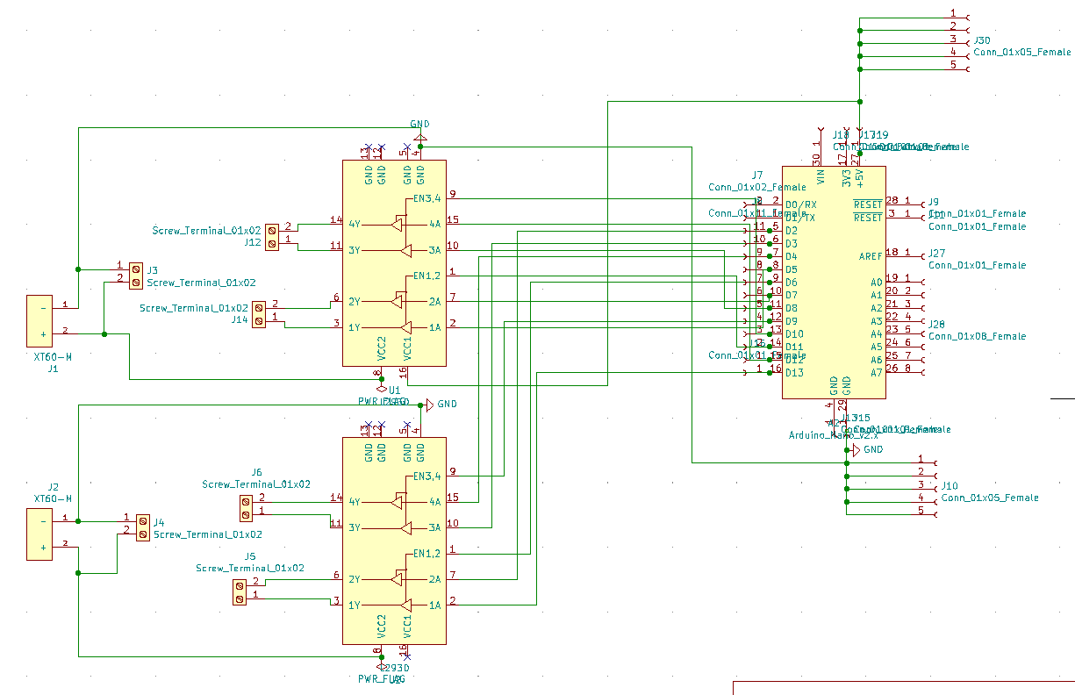
APPROACH
The software tool used for creating PCB-2 is KiCAD.
SCHEMATIC DIAGRAM

Slide 9
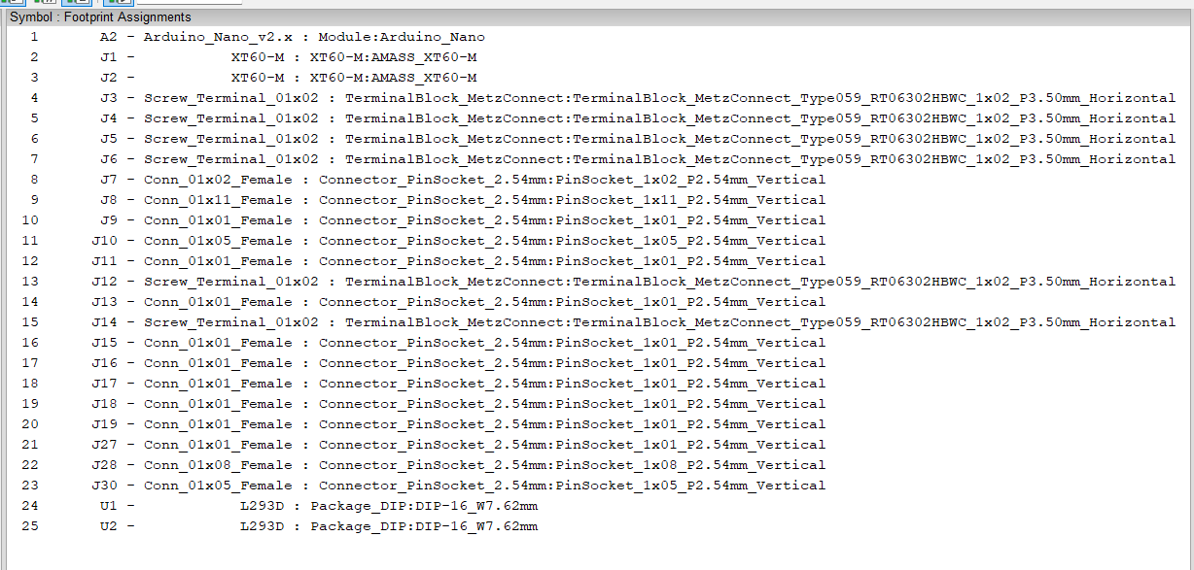
FOOTPRINTS ASSIGNED

Slide 10
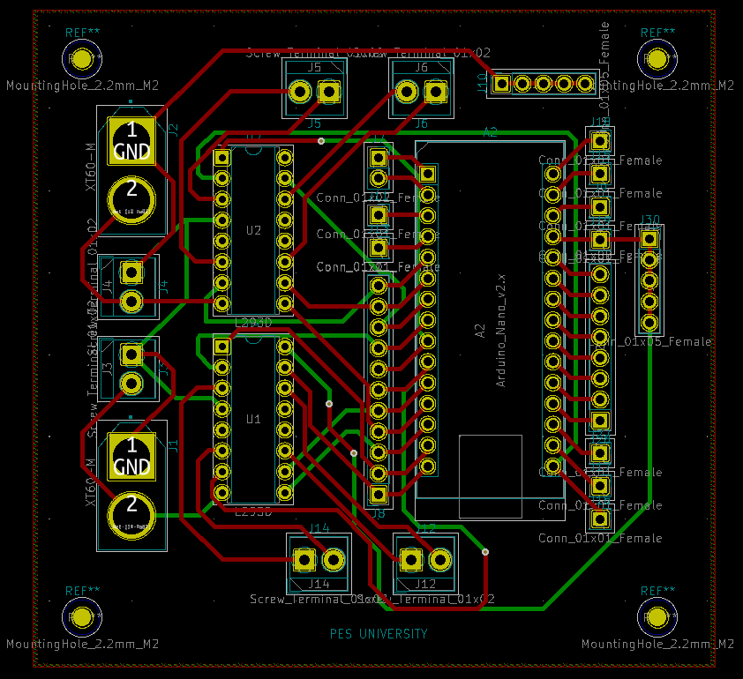
ROUTING

Slide 11
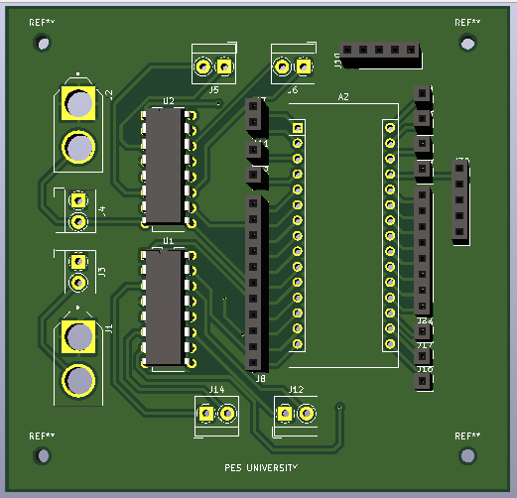
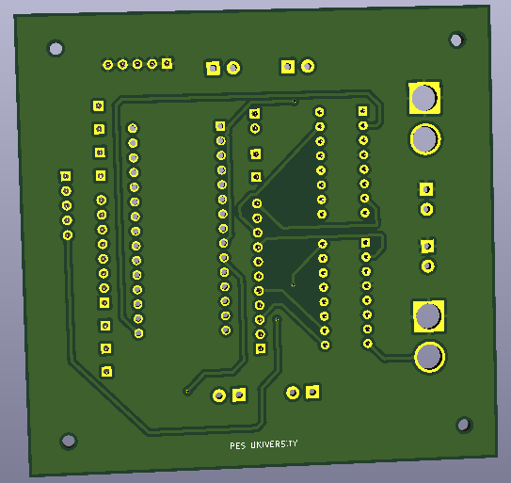
3D VIEW

